Slide 1

Inclusive Language
Diversity in professional writing

Slide 2
Inclusive language in professional writing
Exclusive language can have a big impact on other people. It is important to be mindful of the language we use when communicating.
Diversity in the workplace is ever present. It is important to make each possible receiver of your message feel included and welcome.
Do not single our any one person or group
Do not assume that of a person’s capability, intelligence, or work ethic based any differing factor.
Common areas of diversity: race, age, sexual orientation, gender identity, and disability

Slide 3
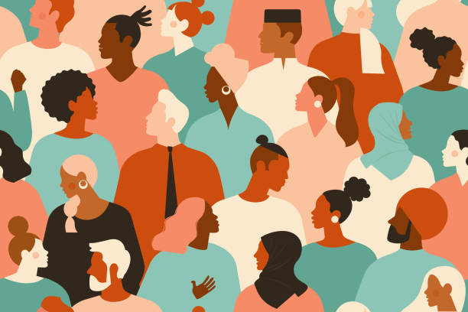
RACE
Stereotypes are harmful. It assumes behaviors, personalities, ideals, etc. of a person. These assumptions cause harm to those on the receiving end.
Do not use stereotypes, even they seem positive
Avoid terms that differentiate any one person from another or imply a higher societal standing such as the term: non-white

Slide 4
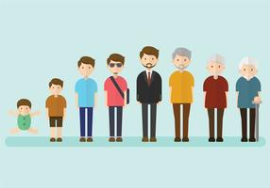
AGE
Avoid using a person’s age when age is irrelevant.
If relevant, do not use terms that may be offensive.
  Do not refer to older people are elderly or seniors.
  People who are younger than you, yet still adults, are not children.
    Avoid using terms such as the kids, the young ones, the babies of the office.

Slide 5
SEXUAL ORIENTATION
Sexual orientation should never be used as nouns. Sexual orientation is one part of a whole person. A person should never be labeled by their sexual orientation or referred to as such.
Never assume somebody’s sexual orientation.
Avoid using terms that assume the nature of relationships.
Neutral terms include: spouse, partner, significant other.

Slide 6
Sexual Orientation
Do not make assumptions
When writing a message to a specific person, use the pronouns of their preference. If you do not know, use gender neutral pronouns.
If pronoun preference is unknown, or the message is going to a group of people, use gender neutral pronouns. Do not exclude any one group by using binary terms such as he/she, hers/his, guys/girls
  They/them is gender neutral
  Avoid referring to a group as “the guys”, when referring to a gender neutral group
  Use gender neutral terms in all messages: instead of businessman- use business person. Instead of chairman- use chair person

Slide 7

DISABILITY
People are people. A disability, much like the other areas discussed, do not make a whole person.
When the information is irrelevant, do not include that information
Avoid using disabilities as a way to describe people
Avoid terms that illude in any way to stigmas regarding disability (whether physical, mental, or sensory)

Slide 8
REMINDER
If the information is not relevant to the message, leave it out.
Be mindful of the terms used that exclude in any way.
Be courteous of others. Use gender neutral terms and only use specific terms when a message is for specific person that you are knowledgeable about their preference.
All the areas discussed are just parts of peoples’ lives. Treat each person has a whole person who are made up of so much more than these things.
WHEN IN DOUBT, LEAVE IT OUT

